Slide 1
Jose Ramon Morales
Partner, Head of Technology & Outsourcing Group, Co-head of Garrigues Digital
Garrigues (Spain)

Slide 2
INDEX
Particular features of the financial institutions (FI)
Current trends and forces affecting the FI
Legal framework affecting FI’s IT sourcing
Key legal issues of IT sourcing in FI
New challenges for IT sourcing in FI

Slide 3
I. Particular features of the financial institutions (FI)
Highly regulated and subject to strong supervision/compliance duties
Data intensive business
Storage and processing of huge amounts of sensitive and valuable info (exposure to cyberattacks)
Intensive dependence on IT / but systems architecture (core systems) still mainly based on heavy and expensive legacy systems

Slide 4
II. Current trends and forces affecting the FI
Pressure on efficiency in a scenario of reduced margins
Dramatic market consolidation in certain countries (2008-2016): IT sourcing offer has being adapted (loss of options for smaller banks and FI)
Innovative enabling technologies available - ability to transform the operations, delivery of services and user experience
Mobile
Cloud solutions and virtualization
Advanced data analytics
AI and machine learning
Biometrics and identity management
… and more to come: Blockchain and DLTs, quantum computing, IoT, ...
New customer expectations and new disruptive players (FinTechs, BigTechs)
Threatens and opportunities for existing FI (digital transformation, inorganic growth, partnerships)

Slide 5
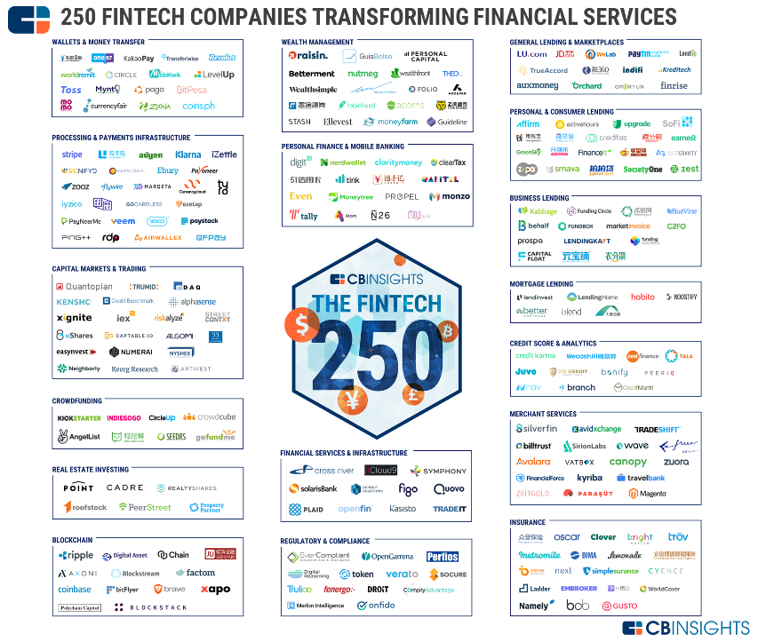
II. Current trends and forces affecting the FI
Source: CB Insights, July 2017
www.cbinsghts.com

Slide 6
III. Legal framework affecting FI’s IT sourcing
Main areas of regulation and supervision in Europe
Financial services regulation (banks & credit institutions, payment entities, insurance, investment services)
Prudential supervision and financial stability: operational risk, business continuity, access of supervision authorities, resolution of FI
Financial conduct: payment services (PSD2), MiFID 2, IDD, ...
Security of data and systems
Personal data protection (GDPR)
RTS on strong customer authentication and common and secure communication under the PSD2
Industry standards (PCI-DSS, ...)
NIS Directive - FI as “operators of essential services”
AML/KYC

Slide 7
III. Legal framework affecting FI’s IT sourcing
Regulation of outsourcing in FI – largest European countries
France
Germany
UK
Italy
Spain

Slide 8
IV. Key legal issues of IT sourcing in FI
The outsourcing policy as a key corporate framework
Planning and designing the sourcing process
Selection of vendor / due diligence
Selection of IT sourcing perimeter (core, non-core systems), model (on-premises, cloud-based) and specific technologies to be adopted
Selection of contracting period and exit strategies
Contracting process
RFP
Competitive negotiations with multiple vendors (simultaneous negotiation streams): pros and cons
Key contract provisions
Risk management and ongoing monitoring

Slide 9
V. New challenges for IT sourcing in FI
Particularities of certain environments
Multivendor scenarios
Adoption of cloud-based solutions
OSS: risks and opportunities
Software development: waterfall vs agile methodologies

Slide 10
V. New challenges for IT sourcing in FI
IT sourcing in the new FinTech era
Open banking requirements and security of data and systems
Banks required to adapt their IT infrastructure to the new access requirements
The technical conditions for new third party service providers to access to bank information
The “API divide” perspective: functions and IT systems in each side and regulatory requirements
Challenger banks and other disruptive players in the financial industry
Regulated new players
Licensing process and requirements on IT systems
Impact on operational, compliance risk: capital requirements
Outsourcing and partnering risk
Unregulated activities and the “grey area”: does any authority supervise the new players’ IT systems and data security?
The debate on the risks of under-regulation or over-regulation in innovative/disruptive business models
The “Sandbox” approach
IT challenges in other partnerships and collaboration schemes between existing FI and new disruptive players: security, compatibility

Slide 11
THANK YOU FOR YOUR ATTENTION!
jose.ramon.morales@garrigues.com

